Slide 1
y variable | X variable | Hypothesis test | Distribution Table FOR FINDING p-value
NUMERICAL | CATEGORICAL WITH 2 TYPES OR GROUPS | 2 SAMPLE INDEPENDENT T TEST | STUDENT T DISTRIBUTION TABLE
NUMERICAL | CATEGORICAL WITH MORE THAN 2 TYPES OR GROUPS | ANOVA SINGLE FACTOR | F DISTRIBUTION TABLE
CATEGORICAL | CATEGORICAL | CHI- SQUARE TEST OF INDEPENDENCE | CHI DISTRIBUTION TABLE

Slide 2
Open a New Jupyter Notebook – Save the notebook as Mini Project 1
Import mtcars.csv as mtcars
Head
Tail
Shape
Dtypes
Describe
Check for missing values
Histogram of mpg
Box plot of mpg
Density curve of mpg
Histogram of wt
Boxplot of wt
Density curve of wt
Count the Frequency of am
Count the Frequency of gears
Count the frequency of carb
Cross tabulation of am and gears
Cross tabulation of gears and carb
Correlation of mtcars
Covariance of mtcars
Stacked Bar plot of am & gears
Stacked Bar plot of gears and carb
Groupby mpg with am
Groupby mpg with gears
Groupby wt with am
Groupby wt with carb
NOTE: Submit the project to
ml@verzeo.in
With your name, payment ID(MOJO ID) and mobile number.
Only if we receive an email with your projects, you will be allowed to take up the test.
Minor project submission must be done within 24 hours.

Slide 3
Using If statement encode am variable 0 is automatic & 1 is manual as AutoType
Using if statement encode mpg variable as high mileage, medium mileage & low mileage as Mileage Type
Using if statement encode wt variable as heavy wt car, medium wt car and low wt car as WtType
Conduct Hypothesis test Average mpg of Automatic & manual cars is equal
Conduct Hypothesis test Average mpg of different gears is equal
Conduct Hypothesis test mpg & Wt Type
Conduct Hypothesis Test on Mileage Type & Wt Type
NOTE: Submit the project to
ml@verzeo.in
With your name, payment ID(MOJO ID) and mobile number.
Only if we receive an email with your projects, you will be allowed to take up the test.
Minor project submission must be done within 24 hours.

Slide 4
MULTIPLE LINEAR REGRESSION

Slide 5
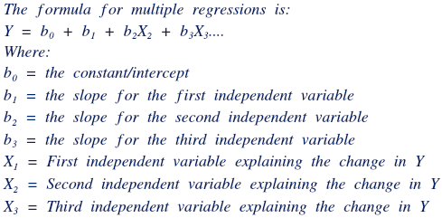
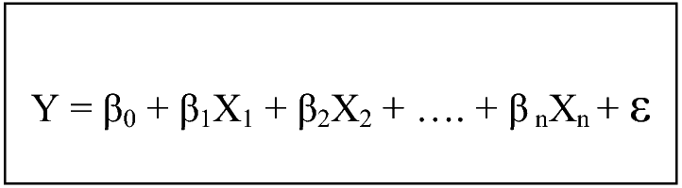
Y is the Dependent variable or Target Variable or Response variable.
Y must be Numerical, Continuous, Normally Distributed, no missing values & no outliers
X’s are multiple independent variables or predictors that can be both numerical & categorical
As a predictive analysis, the multiple linear regression is used to explain the relationship between one continuous dependent variable and two or more independent variables.
The independent variables can be continuous or categorical (dummy coded as appropriate).

Slide 6
There are 3 major uses for multiple linear regression analysis.
First, it might be used to identify the strength of the effect that the independent variables have on a dependent variable.
Second, it can be used to forecast effects or impacts of changes. That is, multiple linear regression analysis helps us to understand how much will the dependent variable change when we change the independent variables.
Third, multiple linear regression analysis predicts trends and future values. The multiple linear regression analysis can be used to get point estimates.

Slide 7
Interpretation of Output
First Parameter to check in Multiple Linear Regression
R squared", is the proportion of the variance in the dependent variable that is predictable from the independent variable(s).
The adjusted R-squared is a modified version of R-squared that has been adjusted for the number of predictors in the model.
The adjusted R-squared increases only if the new term improves the model more than would be expected by chance. It decreases when a predictor improves the model by less than expected by chance.
The adjusted R-squared should be between 0.60 – 0.90. Above 0.90 is over fitting problem which needs to be corrected.

Slide 8
Interpretation of Output
Second Parameter to check in Multiple Linear Regression
Model p-value or Significance F
The F-test of overall significance indicates whether your linear regression model provides a better fit to the data than a model that contains no independent variables.
The null hypothesis states that the model with no independent variables fits the data as well as your model. Null – The Coefficients (ß’s) are equal to zero
The alternative hypothesis says that your model fits the data better than the intercept-only model. Alternate – The Coefficients (ß’s) are NOT equal to zero
The p-value must be less than 0.05 so that we reject the Null Hypothesis

Slide 9
Interpretation of Output
Third Parameter to check in Multiple Linear Regression
Independent Variables p-values must be less than 0.05.
The p-value for each independent variable tests the null hypothesis that the variable has no correlation with the dependent variable.
If there is no correlation, there is no association between the changes in the independent variable and the shifts in the dependent variable.
If the independent variable pvalue is grater than 0.05 that means that independent variable has no relationship or no correlation with Dependent variable.
We should remove such variables and rebuild the model again

Slide 10
Interpreting Regression Coefficients for Linear Relationships
The sign of a regression coefficient tells you whether there is a positive or negative correlation between each independent variable the dependent variable.
A positive coefficient indicates that as the value of the independent variable increases, the mean of the dependent variable also tends to increase.
A negative coefficient suggests that as the independent variable increases, the dependent variable tends to decrease.
The coefficient value signifies how much the mean of the dependent variable changes given a one-unit shift in the independent variable while holding other variables in the model constant.

Slide 11
Mini Project 2
PART - A
In the Datasets Bits Folder there is Insurance_Data.csv file
Convert the CSV file to .xlsx work book
Conduct the Multiple Linear Regression using Losses as Target Variable & do not include Policy Number.
Fit the Model – Interpret & Analyse the Three parameters of output
Write the Regression Equation & Calculate RMSE

Slide 12
Mini Project 2
PART - B
In the Datasets Bits Folder there is Insurance_Data.csv file import the File in new jupyter note book
Head, Tail, Describe, Shape, Dtypes, Column names
Histogram, Box plot, Density Curve of Losses
Value_counts of Number of Vehicles, Gender, FuelType & Married
Cross Tabulation of Number of Vehicles & Gender
Cross Tabulation of FuelType & Married
Label Encode the variables Gender, Married, FuelType,
Create y & X
Conduct Multiple Linear Regression
Regression Equation
Predict the Losses
Root Mean Square Error of Losses

Slide 13
DECISION TREE MODEL

Slide 14
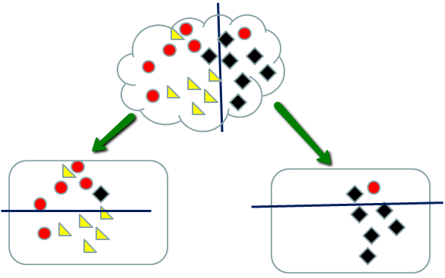
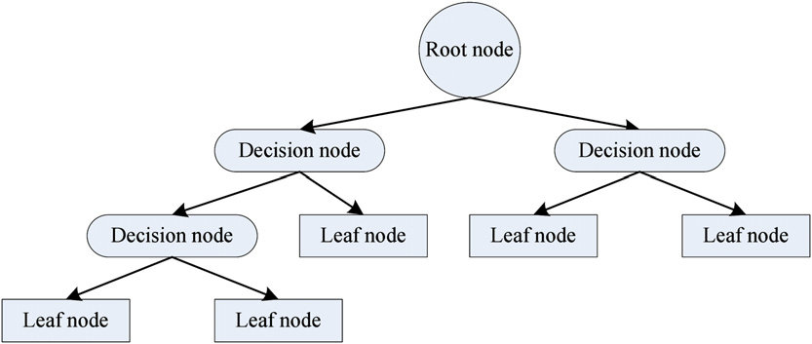

Slide 15
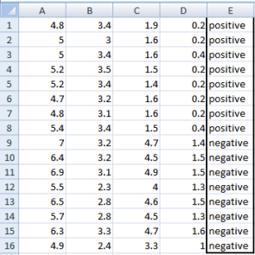

Slide 16
Var C
Gini of Target & Variable C
Prob(>=4.2&Pos) = 0/6 = 0
Prob(>=4.2 &Pos) = 6/6=1
Gini(0,6)= 1 – ((0/6)^2 + (6/6)^2)= 0
Prob (<4.2 & Pos) = 8/10 = 0.8 = 0.8^2=0.64
Prob(<4.2 & neg) = 2/10 = 0.2 = 0.2^2 = 0.04
Gini (8,2) = 1- (0.64+0.04) =0.32
Gini (Target , Var C) = 6/16 *0 + 10/16*0.32 = 0.20
Gini (Target, Var A) = 0.458
Gini(target, Var B)= 0.3345
Gini (taget, var c) =0.2
Gini(taget, var D) = 0.273
>=4.2
<4.2
Negative
Var D
>=1.4
<1.4
Negative
Var B
Tree Splits from Lowest Gini in Ascending Order . Gini above 0.40 not considered in the Tree
>=3
<3
Positive
Negative

Slide 17
Entropy & information Gain
Entropy of Variable E (Target Variable)
Positive – 8 Negative -8
Entropy(8,8) = -1*((8/16)*(log2(8/16)+(8/16)*(log2(8/16)) = 1
Entropy of Variable A
Prob(>=5&pos) = 5/12
Prob(>=5&Neg)=7/12
Entropy(5,7) = -1* ((5/12)*log2(5/12)+(7/12)*log2(7/12)) = 0.9709
Prob(<5 & pos) =3/4
Prob(<5&Neg)=1/4
Entropy(3,1) = -1 *((3/4)*log2(3/4)+(1/4)*log2(1/4))= 0.81128
Entropy (target, Var A) = (12/16)*0.9709 + (4/16)*0.81128 = 0.937745
Information Gain Var A = Entropy of Target – Entropy of Var A = 1- 0.937745 = 0.062255

Slide 18
Information Gain Var A = Entropy of Target – Entropy of Var A = 1- 0.937745 = 0.062255
Information Gain Var B = 1 – 0.292905 = 0.7070795
Information Gain Var C= 1 – 0.4512 = 0.5488
Information Gain Var D = 1 – 0.58115 = 0.41189
Variable B
>=3
<3
Variable C
Negative
>=4.2
<4.2
TREE SPLITS WILL NOT CONSIDER IF INFORMATION GAIN IS LESS THAN 0.40 . That variable will not be part of tree
Variable D
Negative
<1.4
>=1.4
Negative
Positive

Slide 19
ENSEMBLE METHODS – BOOTSTRAP AGGREGATION OR BAGGING – RANDOM FOREST

Slide 20
ENSEMBLE METHODS – MULTI TREE MODELS
BOOTSTRAP AGGREGATING – BAGGING METHOD
SPECIFY THE NUMBER TREES TO BE BUILT ( N.TREES – 1000,5000,10000)
THE DATASET WILL BE SEGGREGATED INTO AS MANY SAMPLES EQUIVALENT TO NUMBER OF TREES
DATA WITH REPLICATION PROCESS OR REPLACEMENT IS USED FOR SAMPLE CREATION
FOR EACH SAMPLE INDIVIDUAL DECISION TREES ARE CREATED PARALLELY
FOR EACH TREE IF IT IS CLASSIFICATION – SQUARE ROOT OF NUMEBER OF VARIABLES WILL BE CONSIDERED FOR EACH TREE – SQRT(N.VARIABLES)
FOR REGRESSION NUMBER OF VARIABLES/3

Slide 21
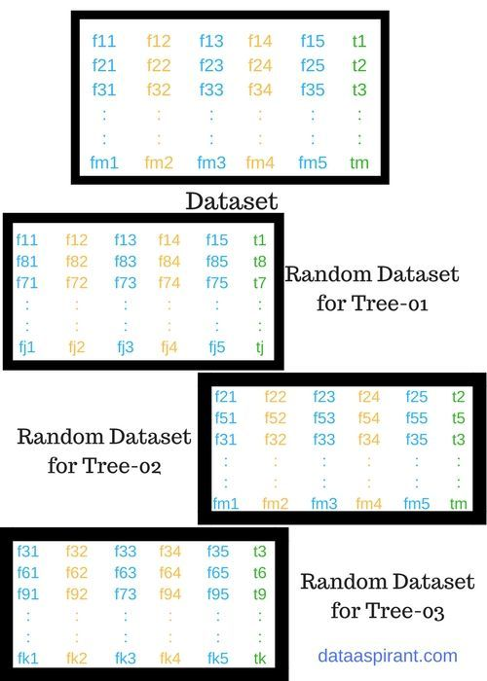

Slide 22
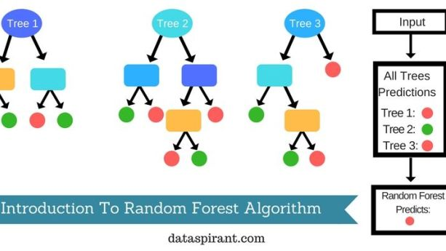

Slide 23
Building many decision trees results in a forest. A random forest works the following way: First, it uses the Bagging (Bootstrap Aggregating) algorithm to create random samples.
Given a data set D1 (n rows and p columns), it creates a new dataset (D2) by sampling n cases at random with replacement from the original data. About 1/3 of the rows from D1 are left out, known as Out of Bag(OOB) samples.
Then, the model trains on D2. OOB sample is used to determine unbiased estimate of the error.
Out of p columns, P << p columns are selected at each node in the data set. The P columns are selected at random.
Usually, the default choice of P is p/3 for regression tree and P is sqrt(p) for classification tree.
Unlike a tree, no pruning takes place in random forest; i.e, each tree is grown fully. In decision trees, pruning is a method to avoid overfitting. Pruning means selecting a subtree that leads to the lowest test errror rate.
We can use cross validation to determine the test error rate of a subtree.
Several trees are grown and the final prediction is obtained by averaging or voting. Since random forest has the feature to calculate OOB error internally, cross validation doesn't make much sense in random forest.

Slide 24
ENSEMBLE METHODS – BOOSTING TREES – GRADIENT BOOSTING MACHINES

Slide 25
Gradient Boosting Trees
The algorithm for Boosting Trees evolved from the application of boosting methods to regression trees.
The general idea is to compute a sequence of (very) simple trees, where each successive tree is built for the prediction residuals of the preceding tree.
As described in the General Classification and Regression Trees Introductory Overview, this method will build binary trees, i.e., partition the data into two samples at each split node.
Now suppose that you were to limit the complexities of the trees to 3 nodes only: a root node and two child nodes, i.e., a single split. Thus, at each step of the boosting (boosting trees algorithm), a simple (best) partitioning of the data is determined, and the deviations of the observed values from the respective means (residuals for each partition) are computed.

Slide 26
Gradient Boosting Trees
The next 3-node tree will then be fitted to those residuals, to find another partition that will further reduce the residual (error) variance for the data, given the preceding sequence of trees.
It can be shown that such "additive weighted expansions" of trees can eventually produce an excellent fit of the predicted values to the observed values, even if the specific nature of the relationships between the predictor variables and the dependent variable of interest is very complex (nonlinear in nature).
Hence, the method of gradient boosting - fitting a weighted additive expansion of simple trees - represents a very general and powerful machine learning algorithm.

Slide 27
CLASSIFICATION ALGORITHMS
Target Variable – NON Numerical in Binary Format YES/NO or TRUE/FALSE 0R MULTINOMIAL FORMAT MORE THAN 2 TYPES – STRONGLY AGREE, AGREE, NEUTRAL, DISAGREE, STRONGLY DISAGREE – LIKERT SCALE

Slide 28
BINARY LOGISTIC REGRESSION
Logistic Regression is a classification algorithm. It is used to predict a binary outcome (1 / 0, Yes / No, True / False) given a set of independent variables.
To represent binary / categorical outcome, we use dummy variables.
Logistic regression as a special case of linear regression when the outcome variable is categorical, where we are using log of odds as dependent variable.
In simple words, it predicts the probability of occurrence of an event by fitting data to a logit function.
In logistic regression, we are only concerned about the probability of outcome dependent variable ( success or failure).

Slide 29
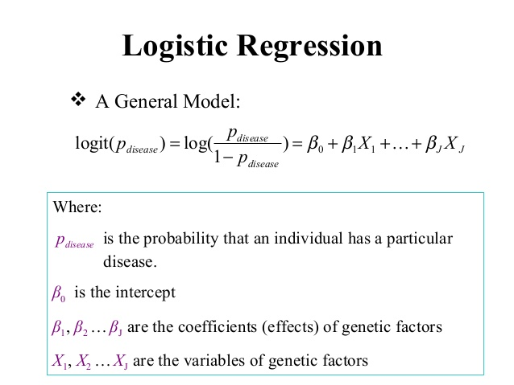

Slide 30
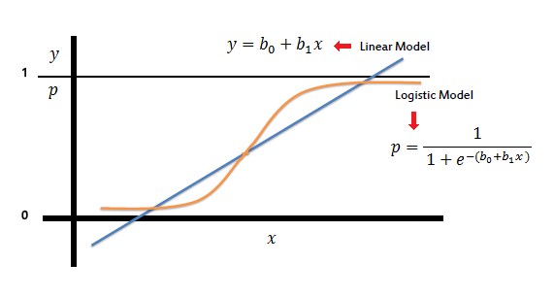

Slide 31
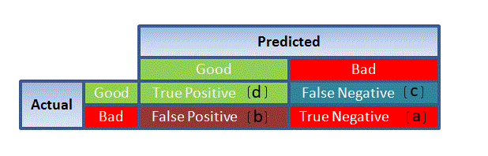
INTERPRETATION
AIC (Akaike Information Criteria) – The analogous metric of adjusted R² in logistic regression is AIC. AIC is the measure of fit which penalizes model for the number of model coefficients. Therefore, we always prefer model with minimum AIC value.
Null Deviance and Residual Deviance – Null Deviance indicates the response predicted by a model with nothing but an intercept. Lower the value, better the model. Residual deviance indicates the response predicted by a model on adding independent variables. Lower the value, better the model.
Confusion Matrix: It is nothing but a tabular representation of Actual vs Predicted values. This helps us to find the accuracy of the model and avoid overfitting. This is how it looks like:

Slide 32
NEURAL NETWORK WITH 3 NEURONS IN HIDDEN LAYER
INPUT | OUTPUT
0,0, | 0
0,1 | 1
1,0 | 1
1,1 | 0
INPUT LAYER
INPUT LAYER WEIGHTS
HIDDEN LAYER
OUTPUT LAYER
OUTPUT LAYER WEIGHTS
H1
1
I1 .1
0.8
0.3
0.4
FEED FORWARD NEURAL NETWORK – IL – HL - OL
0.3
H2
1.3
0
0.5
0.2
STEP=1
H1= (1*0.8)+(1*0.2) = 1 I1*W1 + I2*W4
H2= (1*0.4) +(1*0.9) = 1.3
H3= (1*0.3)+(1*0.5) = 0.8
STEP 2
SIGMOID ACTIVATION FUNCTION TO ACTIVATE THE VALUES = 1/(1+(EXP)^-Z)
SIGMOID H1 = 1/(1+EXP(-1)) = 0.7310589
SIGMOID H2= 1/(1+EXP(-1.3)) =0.785834983
SIGMOID H3 = 1/(1+EXP(-0.8))=0.68997448
I2. 1
0.9
H3
0.8
0.9
0.5
THE WEIGHTS MUST BE BETWEEN 0 & 1. BUT THE SUM OF WEIGHTS NEED NOT BE EQUAL TO 1.

Slide 33
STEP -3
MULTIPLY SIGMOID VALUES WITH OUTPUT WEIGHTS & SUM UP
0.73105857 * 0.3 + 0.785834983*0.5 + 0.6899974481*0.9 = 1.233212
STEP 4
SIGMOID OF STEP 3
=1/(1+EXP(-1.2333212)) = 0.77438 (Predicted Probability Value)
ERROR – ACTUAL VALUE – PREDICTED VALUE
0 - 0.77438 = - 0.77438
BACKWARD PROPOGATION
STEP 1
SIGMOID PRIME OF DERIVATIVE FUNCTION = S(X)*(1-S(X))
= 0.77438 *(1- 0.77438 ) = 0.174715

Slide 34
STEP – 2
MULTIPLY ERROR * Sigmoid Prime Derivative
= 0.174715 * - 0.77438 = -0.1353
Step 3
Delta output weights = STEP 2 / SIGMOID OF HIDDEN LAYERS
= -0.1353/0.731055579 = -0.18507
=-0.1353/ 0.785834983 = -0.17217
=-0.1353/0.689974481 = -0.19609
STEP 4
NEW OUTPUT WEIGHTS
=0.3 -0.18507 = 0.11493
=0.5 -0.17217=0.32783
=0.9 -0.19609=0.703911
STEP 5
Delta INPUT weights = STEP 2 / OUTPUT LAYER WEIGHTS
-0.1353/0.3 = -0.45099
=-0.1353/0.5= -0.27059
=-0.1353/0.9 = -0.15033
STEP 6
STEP5*(S(HIDDENLAYER)*(1-S(HIDDENLAYER))
-0.45099*(0.731055579)*(1-0.731055579)= -0.08867
-0.27059 *(0.785834983)*(1- 0.785834983)=-0.0455
-0.15033*(0.689974481)*(1-0.689974481)=-0.03216
Step 7 NEW Input Layer weights
=0.8- -0.08867= 0.71131
=0.4- 0.0455 = 0.35446
=0.3-0. .03216= 0.267843
=0.2- -0.08867 = 0.111331
=0.9- 0.0455=0.85446
=0.5 - 0 .03216=0.467843

Slide 35
MINI PROJECT 3 – PYTHON
IN DATASETSBITS FOLDER, THERE IS A DATASET BANK-FULL.CSV.
THE DATASET IS CLASSIFICATION DATA SET & TARGET VARIABLE IS ‘y’
IMPLEMENT TWO HYPOTHESIS TESTS
RUN ALL CLASSIFICATION ALGORITHMS & CALCULATE ACCURACY FOR EACH
MINI PROJECT 4 – R
IN DATASETSBITS FOLDER, THERE IS A DATASET BANK-FULL.CSV.
THE DATASET IS CLASSIFICATION DATA SET & TARGET VARIABLE IS ‘y’
IMPLEMENT TWO HYPOTHESIS TESTS
RUN ALL CLASSIFICATION ALGORITHMS & CALCULATE ACCURACY FOR EACH

Slide 36
NATURAL LANGUAGE PROCESSING
Post clean up of hashtags, RT, html links
Corpus of words is created
Analysis –
Frequency of terms
Association or Correlation between words
Hierarchical Clustering of words
Word Cloud
Topic Modelling
N Grams – Bigrams & Trigrams
On Sentences of Tweets
a) Sentiment Analysis will be done

